Slide 1
Chapter 2 Configuration Space
Chapter 3 Rigid-Body Motions
3.2 Rotations and Angular Velocities
3.3 Rigid-Body Motions and Twists
Chapter 4 Forward Kinematics
Chapter 5 Velocity Kinematics and Statics
Chapter 6 Inverse Kinematics
Chapter 7 Kinematics of Closed Chains
Chapter 8 Dynamics of Open Chains
Chapter 9 Trajectory Generation
Chapter 10 Motion Planning
Chapter 11 Robot Control
Chapter 12 Grasping and Manipulation
Chapter 13 Wheeled Mobile Robots

Slide 2
Important concepts, symbols, and equations
The special Euclidean group SE(3) is a matrix Lie group also known as the group of rigid-body motions or homogeneous transformation matrices in ℝ³ .
The inverse of T ∈ SE(3) is

Slide 3
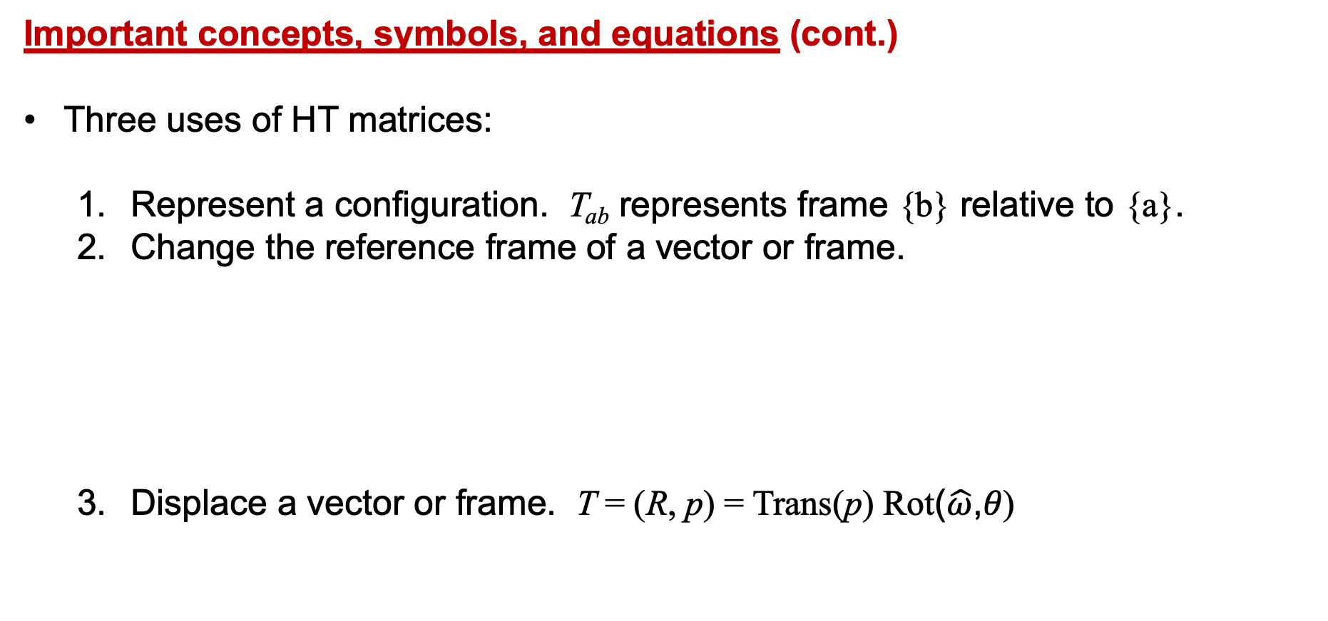
Important concepts, symbols, and equations (cont.)
Three uses of HT matrices:
Represent a configuration. T_{ab} represents frame {b} relative to {a}.
Change the reference frame of a vector or frame.
Displace a vector or frame. T = (R, p) = Trans(p) Rot($\hat{ω}$,𝜃)
v should be written in
homogeneous coordinates,
v = [v₁ v₂ v₃ 1]^{T}.

Slide 4
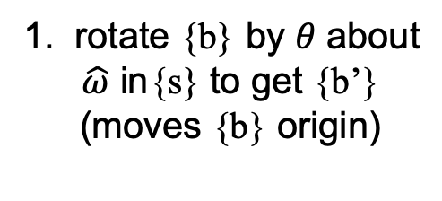
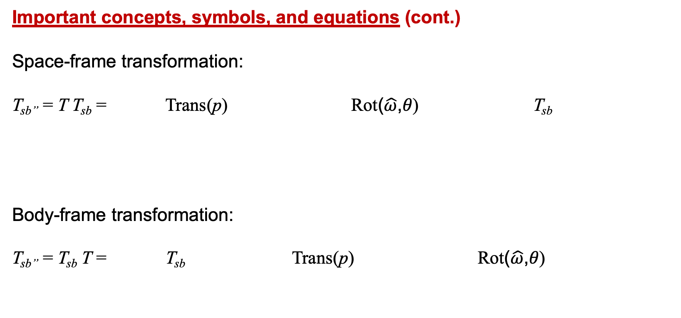
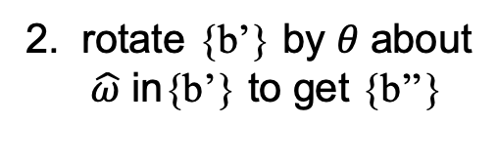
Important concepts, symbols, and equations (cont.)
Space-frame transformation:
T_{sb’’} = T T_{sb} = Trans(p) Rot($\hat{ω}$,𝜃) T_{sb}
Body-frame transformation:
T_{sb’’} = T_{sb} T = T_{sb} Trans(p) Rot($\hat{ω}$,𝜃)
2. translate {b’} by p
in {s} to get {b’’}
1. rotate {b} by 𝜃 about
$\hat{ω}$ in{s} to get {b’}
(moves {b} origin)
1. translate {b} by p
in {b} to get {b’}
2. rotate {b’} by 𝜃 about
$\hat{ω}$ in{b’} to get {b’’}

Slide 5

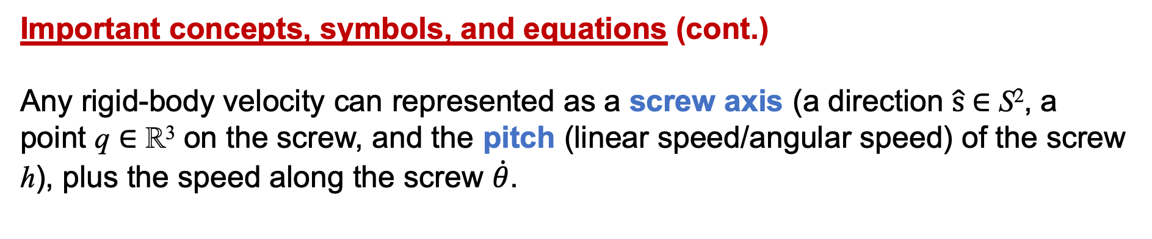
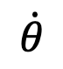
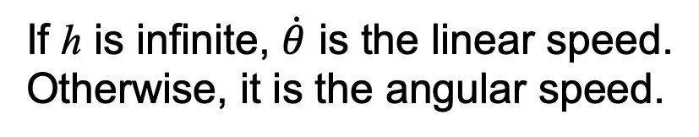
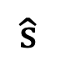
Important concepts, symbols, and equations (cont.)
Any rigid-body velocity can represented as a screw axis (a direction $\hat{\text{s}}$∈ S², a point q ∈ ℝ³ on the screw, and the pitch (linear speed/angular speed) of the screw h), plus the speed along the screw $\dot{θ}$.
$$\hat{\text{s}}$$
q
If h is infinite, $\dot{θ}$ is the linear speed.
Otherwise, it is the angular speed.
$$\dot{θ}$$

Slide 6
Important concepts, symbols, and equations (cont.)
The twist V_{a} = (𝜔_{a} , v_{a}) ∈ ℝ⁶ is the angular velocity expressed in {a} and the linear velocity of the origin of {a} expressed in {a}.
$$\hat{\text{s}}$$
q
$$\dot{θ}$$
body twist V_{b}
spatial twist V_{s}

Slide 7




Important concepts, symbols, and equations (cont.)
To transform a twist from one frame to another,
V_{a} = T_{ab} V_{b}
V_{a} = [Ad_{Tab}] V_{b} , where the adjoint representation of T = (R , p) is
4×4
6×1

Slide 8
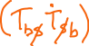
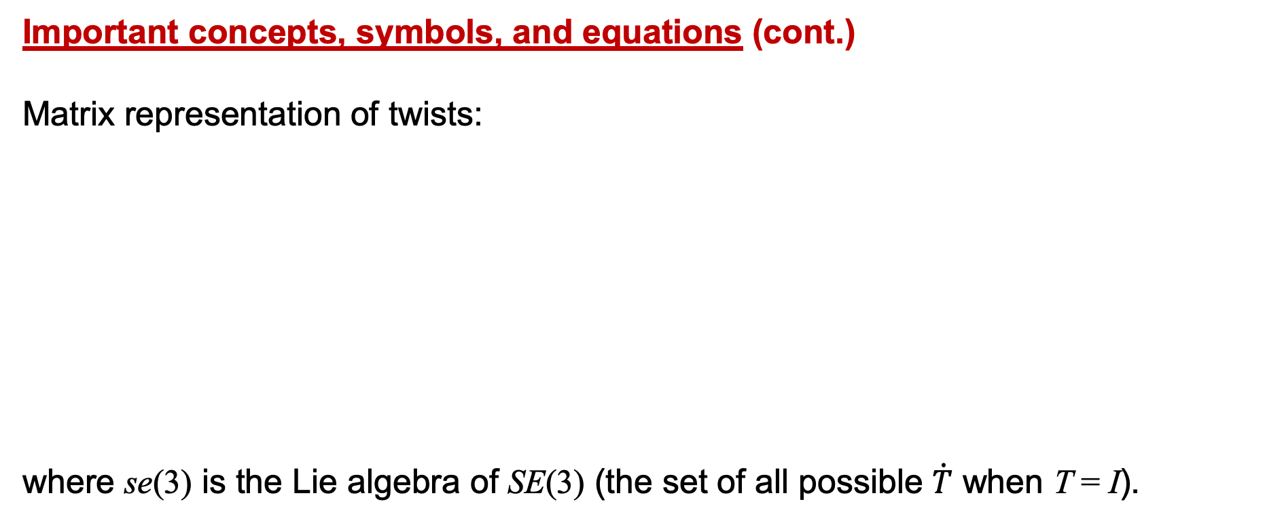

Important concepts, symbols, and equations (cont.)
Matrix representation of twists:
where se(3) is the Lie algebra of SE(3) (the set of all possible $\dot{T}$ when T = I).

Slide 9
Important concepts, symbols, and equations (cont.)
Screws and twists:
•
•
•

Slide 10
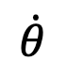
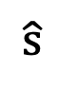
Screws and twists
•
•
•
$$\hat{\text{s}}$$
q
What is the dimension
of the space of screws?
$$\dot{θ}$$

Slide 11




Kinova lightweight 4-dof arm
For J4, what is the screw axis S_{b}? S_{s}?
For J2?

Slide 12

p_{b} = (3,3,0)
Write T_{bc}.

Slide 13





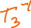
A camera with frame {c} tracks the optical marker on a tool to get its frame {t} relative to {c}. This transformation is T₁. A space frame {s} is attached to the floor of the room, and the camera observes its configuration relative to {c} as T₂. A robot arm has a mounting frame {m} which has been measured relative to {s} as T₃. The arm’s encoders and the robot’s kinematics tell us the gripper’s frame {e} relative to {m}. This is represented as T₄. The gripper should be at the frame {g} relative to {t} to be able to close on the tool and pick it up. This configuration is represented as T₅.
Write T_{eg}, the configuration of the grasping frame {g} relative to the current end-effector frame {e}, in terms of T₁, T₂, T₃, T₄, and T₅.

